Slide 1
UPDATE: PEACE AND VICTIMS’ RIGHTS IN COLOMBIA
TOM LANTOS HUMAN RIGHTS COMMISSION
WASHINGTON, DC
APRIL 8, 2019
JAIME ENRIQUE ARIAS ARIAS
PUEBLO INDIGENA KANKUAMO
COLOMBIA

Slide 2
INDIGENOUS PEOPLES’ VISION OF PEACE
PEACE IS NOT ONLY THE SILENCING OF GUNS.
PEACE IS NOT ONLY AMONG HUMAN BEINGS.
TRUE PEACE SHOULD BE:
  WITH ONESELF: EQUILIBRATE AND PUT IN ORDER THE NEGATIVE AND THE POSITIVE.
  LIVE IN HARMONY WITH FAMILY AND COMMUNITY.
  CARE FOR AND CONSERVE NATURE.
  PROTECT TERRITORY AS A SPACE FOR LIFE, KNOWLEDGE AND FOR LIVING CULTURE.
  EXERCISE OF SELF-GOVERNMENT, AUTONOMY AND SELF-DETERMINATION AMONG PEOPLES.

Slide 3
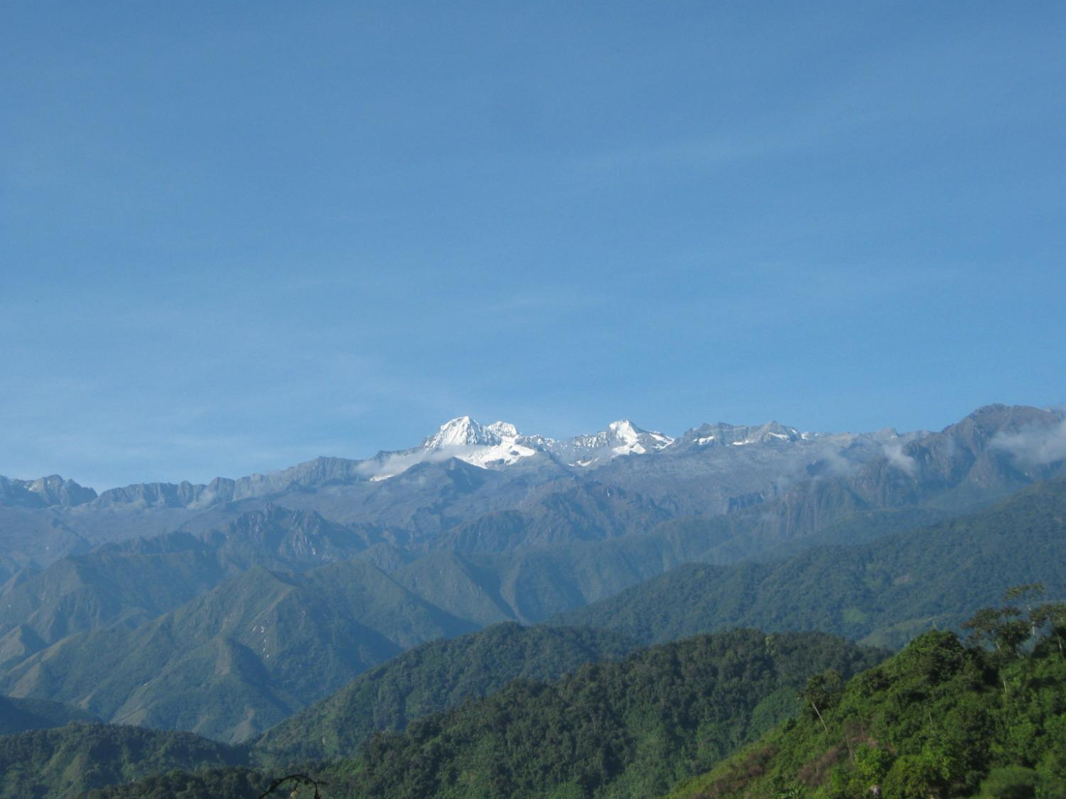
Ancestral Vision of Territorial Order
Spiritual and material order in the Universe, territory and persons. All that exists in nature has the same principles of origin, all are spiritual beings with the same rights as persons.

Slide 4


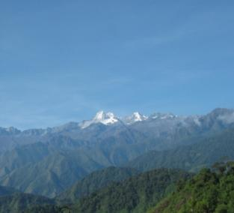
Ancestral Vision of Territorial Order
        Principles for intercultural dialogue:
    For us the Universe is a physically and spiritually unitary reality.
    The origin of things and the determination of their function is based on norms of attitude and behavior for people and for societies in harmonious relation with others and with elements of Mother Nature.
    The norms for environmental order and management are not only written in legal codes but are also enshrined in the origins of nature itself and expressed in each element and its function. This is the Origins document that should be read to govern.
    All that exists in the Universe is in our ancestral territory, represented in sacred sites (Mothers and Fathers), through them communication is maintained and from there the mission of maintaining the equilibrium of the world in a spiritual way is fulfilled.
    To guarantee the protection of sacred spaces is to guarantee the protection of life. What we do with ourselves is reflected in the inhabited world.

Slide 5
IMPLEMENTATION OF THE PEACE ACCORD FOR INDIGENOUS PEOPLES OF COLOMBIA
Implementation of the ethnic chapter.
In the Fast Track proceedings, only (7) norms affecting indigenous peoples and only (1) for Afro-descendant peoples were considered of the at least (16) that were required. Of a total of 107 norms.
Intercultural dialogue on the JEP, in the framework of the development of the integrated system of truth, justice, reparation and no repetition.
PARTICIPATION AND ARTICULATION AMONG THE JEP (Special Peace Jurisdiction), THE JEI (Special Indigenous Jurisdiction) AND THE SJN (National Judicial System).

Slide 6
IMPLEMENTATION OF THE PEACE ACCORD FOR INDIGENOUS PEOPLES OF COLOMBIA
COMPREHENSIVE AGRARIAN REFORM. LEGALIZATION OF LAND, ADQUISITION OF LAND.
14 RURAL DEVELOPMENT PROGRAMS
FORMULATION AND IMPLEMENTATION OF THE PDET (Development Programs with a Territorial Focus).
TERRITORIAL PEACE DISTRICTS LAW. POLITICAL PARTICIPATION.
COMPREHENSIVE PROGRAM FOR SUBSTITUTION OF ILLICIT CROPS.
FRAMEWORK PLAN FOR IMPLEMENTATION OF THE PEACE ACCORD.
HIGH LEVEL BODY OF ETHNIC PEOPLES.

Slide 7
NEW ADVERSE POLITICAL CONTEXT FOR THE PEACE IN COLOMBIA.
OBJECTIONS TO THE JEP.
DEEPENING OF A POLITICAL SYSTEM THAT EXCLUDES AND IN WHICH THE SOCIAL RULE OF LAW IS UNDERMINED. THERE IS NO INDEPENDENCE OF THE POWERS OF THE STATE.
COOPTATION OF THE ESTABLISHMENT BY THE CRIMINAL AND MAFIA SYSTEM THAT HAS GOVERNED COLOMBIA THROUGHOUT ITS HISTORY.
RESURGENCE OF PARAMILITARISM, NARCOTRAFFICKING, PHYSICAL AND CULTURAL EXTERMINATION OF INDIGENOUS PEOPLES.

Slide 8
HUMAN RIGHTS ABUSES AND INFRACTIONS OF IHL AFFECTING INDIGENOUS PEOPLES OF COLOMBIA
AFTER THE SIGNING OF THE PEACE ACCORD
(1 November 2016 - 2019)
TYPE | TOTAL
Threats | 122
Homicides | 38
Attacks | 10
Confinement | 827
Intimidation | 3
Massive Displacement | 3800
Death by Anti-Personnel Mine | 1
Wounded by Anti-Personnel Mine | 1
Forced Recruitment | 10
Sexual Abuse | 1
Theft | 1
Torture | 122
Disappearances | 38
Illegal Detention | 10
Intent to Commit Homicide | 827

Slide 9
INDIGENOUS PEOPLES AND DEPARTMENTS MOST AFFECTED BY MASS FORCED DISPLACEMENT AND CONFINEMENT
DEPARTMENT | MUNICIPALITY | INDIGENOUS PEOPLE | TYPE OF VICTIMIZATION | N° OF PEOPLE
Antioquia | Turbo | Embera Eyadiba | Confinement | 76
Cauca | Timbiqui | Embera Siapidara | Forced displacement | 1012
Choco | Rio Sucio | Wounaan | Forced displacement | 500
Choco | Litoral de San juan | Wounaan | Forced displacement | 134

Slide 10
INDIGENOUS PEOPLES AND DEPARTMENTS MOST AFFECTED BY MASS FORCED DISPLACEMENT AND CONFINEMENT
DEPARTMENT | MUNICIPALITY | INDIGENOUS PEOPLE | TYPE OF VICTIMIZATION | N° OF PEOPLE
Choco | Itsmina, Union Choco San Cristibal | Wounaan | Confinement | 517
Choco | Itsmina Comunidad Puerto Olve | Wounaan | Confinement | 144
Choco | Lloro | Embera Chami | Forced displacement | 602
Choco | Alto Baudo | Embera Dovida. | Forced displacement | 309

Slide 11
INDIGENOUS PEOPLES AND DEPARTMENTS MOST AFFECTED BY MASS DISPLACEMENT AND CONFINEMENT
DEPARTMENT | MUNICIPALITY | INDIGENOUS PEOPLE | TYPE OF VICTIMIZATION | N° OF PEOPLE
Valle del Cauca | Buenaventura | Wounaan | Forced displacement | 106
Valle del Cauca | Buenaventura | Wounaan | Forced displacement | 153
Valle del Cauca | Buenaventura | Wounaan | Forced displacement | 83
Valle del Cauca | Buenaventura | Wounaan | Confinement | 90

Slide 12
AFFECTATIONS AND THREATS TO THE CULTURAL AND TERRITORIAL INTEGRITY OF THE FOUR INDIGENOUS PEOPLES OF THE SIERRA NEVADA

Slide 13
Increase in requests for mining from 2014 to 2017 (orange areas):

Slide 14
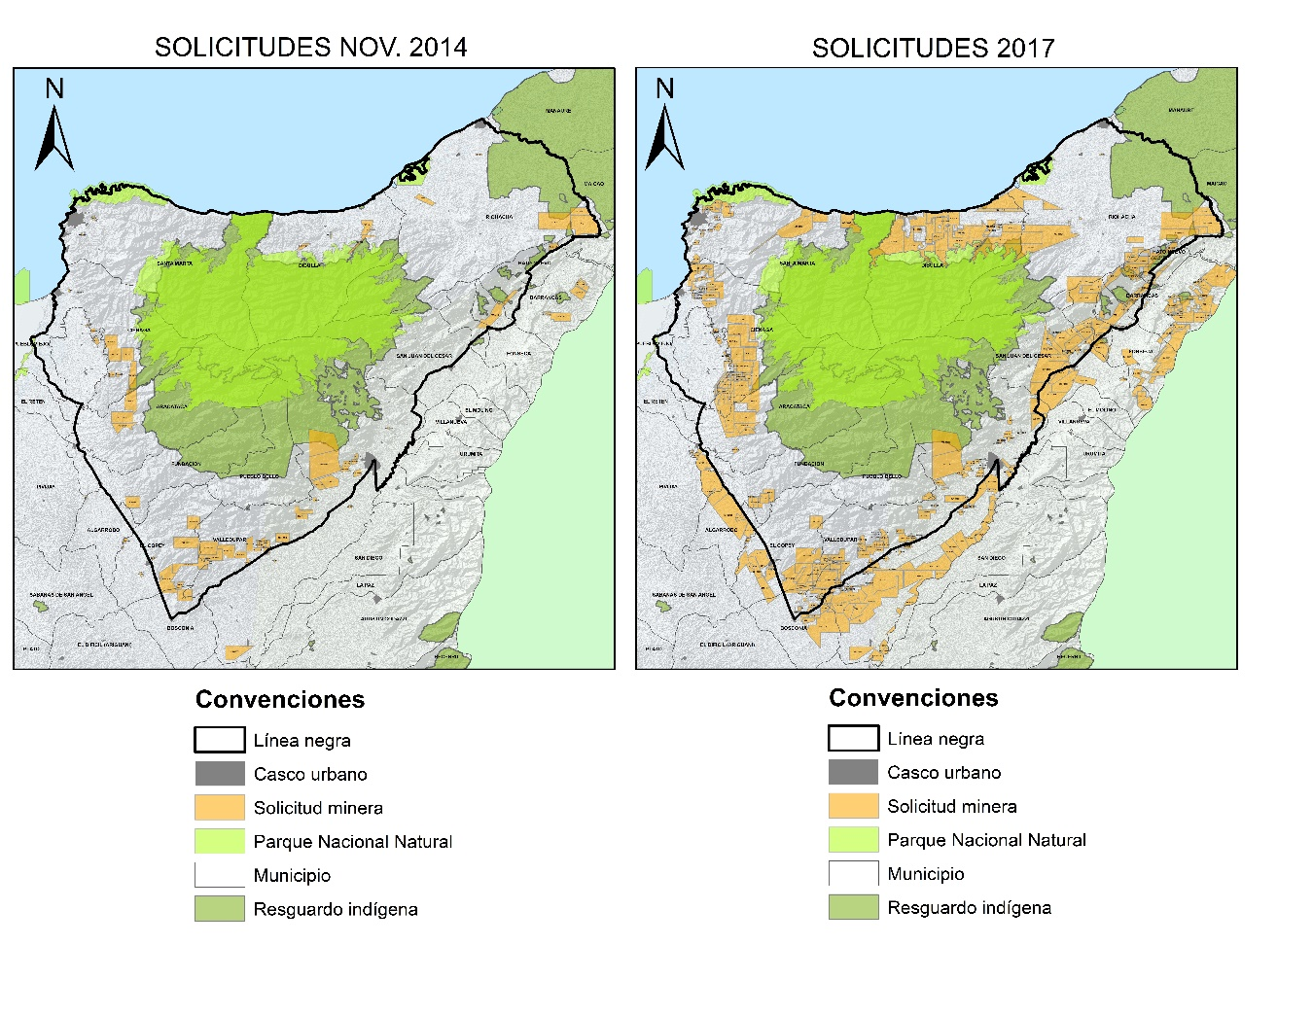

Slide 15
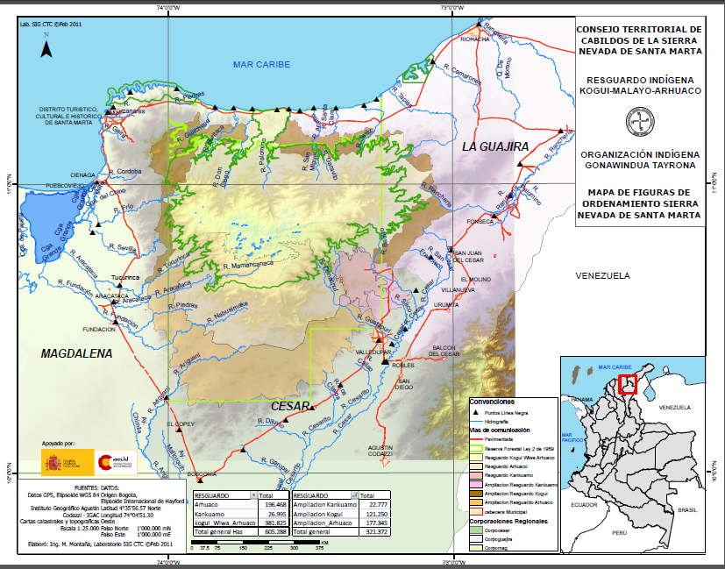
TERRITORIAL COUNCIL OF CABILDOS OF THE SIERRA NEVADA OF SANTA MARTA OF THE KOGI, ARHUACO, WIWA AND KANKUAMO PEOPLES IN ANCESTRAL TERRITORY – BLACK LINE

Slide 16
OUR STRUGGLE TO REMAIN
STRENGTHEN THE EXERCISE OF SELF-GOVERNMENT, AUTONOMY AND SELF-DETERMINATION.
DEFENSE AND PROTECTION OF THE TERRITORY.
SPIRITUAL AND PHYSICAL RENOVATION.
SOCIAL MOBILIZATION TO DEFEND LIFE, THE TERRITORY, PEACE AS A FUNDAMENTAL RIGHT.
INDIGENOUS MINGA FOR THE LIFE AND PEACE OF COLOMBIA.
CONSTRUCTION AND WEAVING OF NETWORKS.

Slide 17
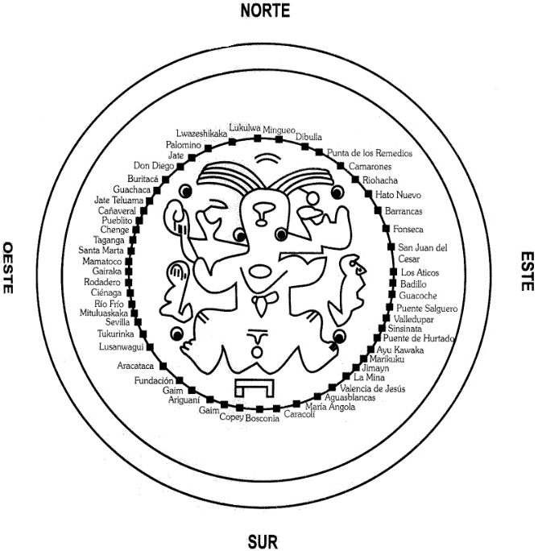
MOTHER DOCUMENT OF THE BLACK LINE - JABA SÉSHIZHA – OF THE FOUR INDIGENOUS PEOPLES OF THE SIERRA NEVADA OF SANTA MARTA

Slide 18
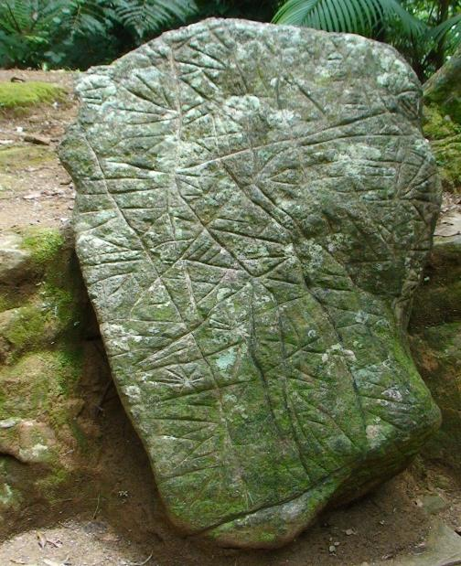
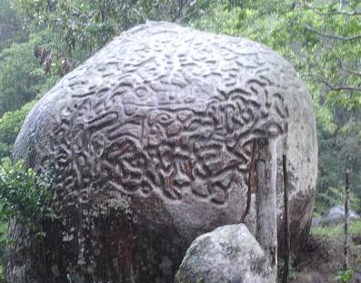

Slide 19
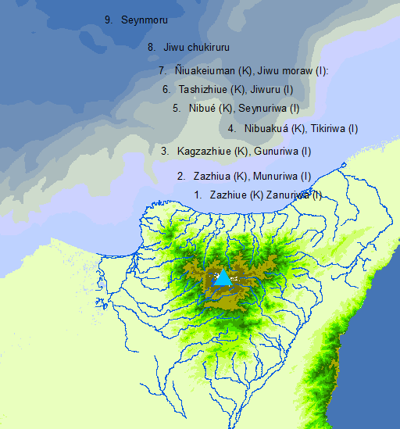

Slide 20
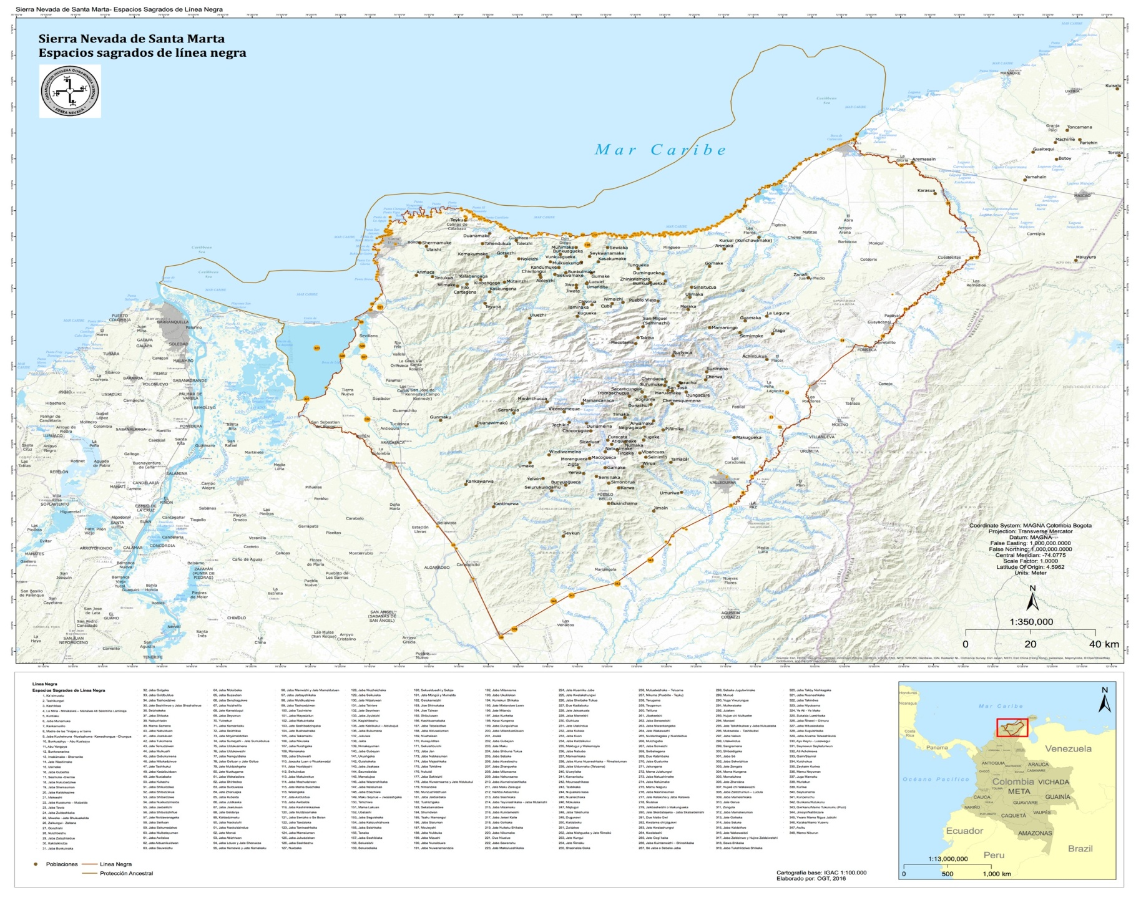
CARTOGRAPHY

Slide 21
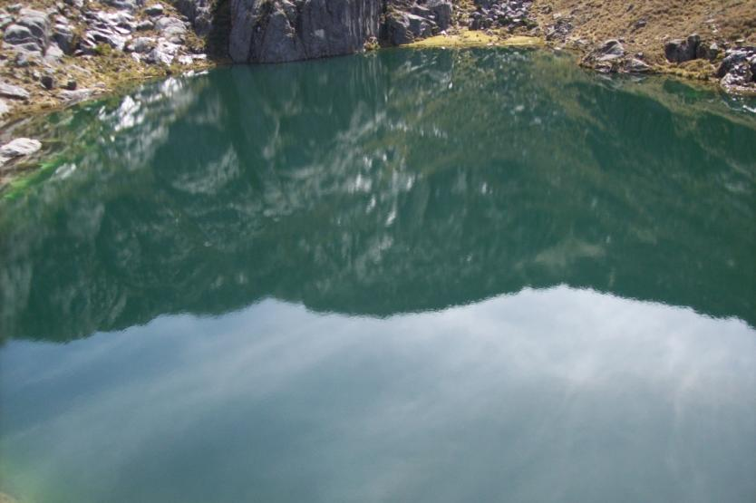
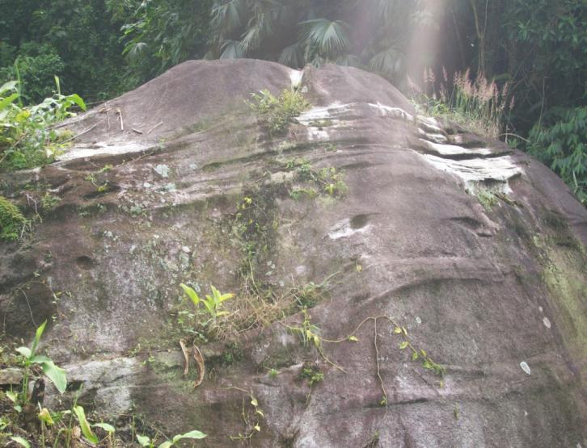
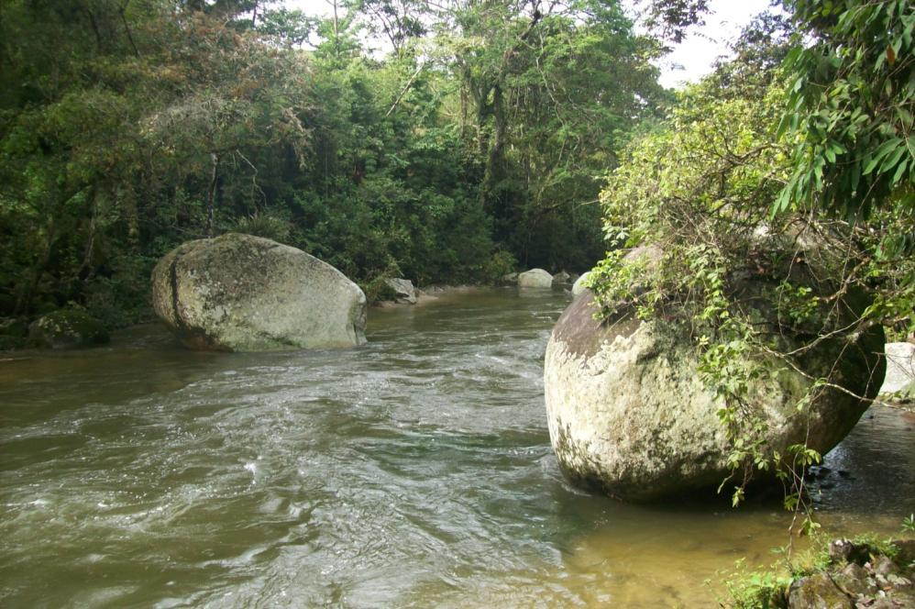
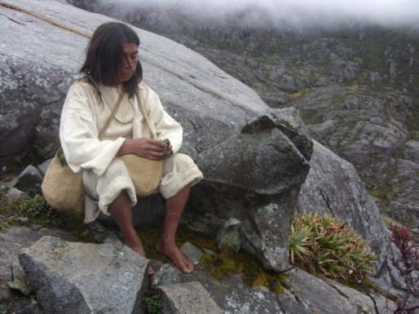
Thank you .. !!

